Slide 1
How to create your own applications with planning
Hankui Zhuo
May 8, 2019

Slide 2
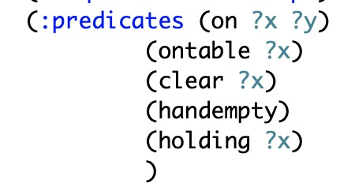
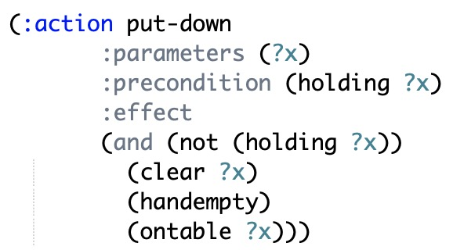
Topic 1: solve 8-puzzle problems
Build domain model
A set of predicates
A set of operators

Slide 3
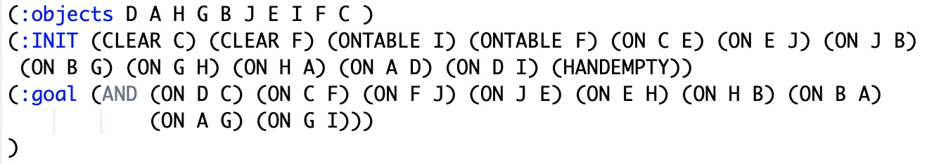
Topic 1: solve 8-puzzle problems (continued)
Build objects, initial and goal states
Objects: all objects involved in your problem
Initial state: a full set of propositions
Goal state: a partial set of propositions

Slide 4
Topic 1: solve 8-puzzle problems (continued)
Main issues:
How many predicates?
Specifying locations of objects
Specifying adjacency of locations
How many operators?
move-up, move-down, move-left, move-right
How many objects?
8 objects: 1, 2, 3, 4, 5, 6, 7, 8
9 locations: A, B, C, D, E, F, G, H, I

Slide 5
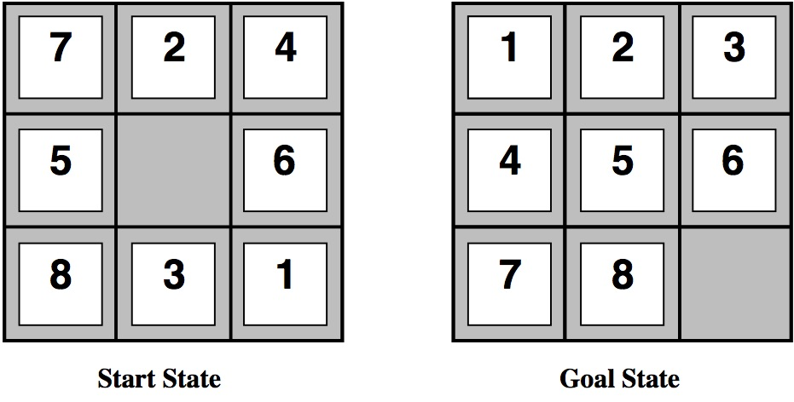
Topic 1: solve 8-puzzle problems (continued)
Input your domain and problem files to:
http://editor.planning.domains
Test your files via solving the following problem:

Slide 6
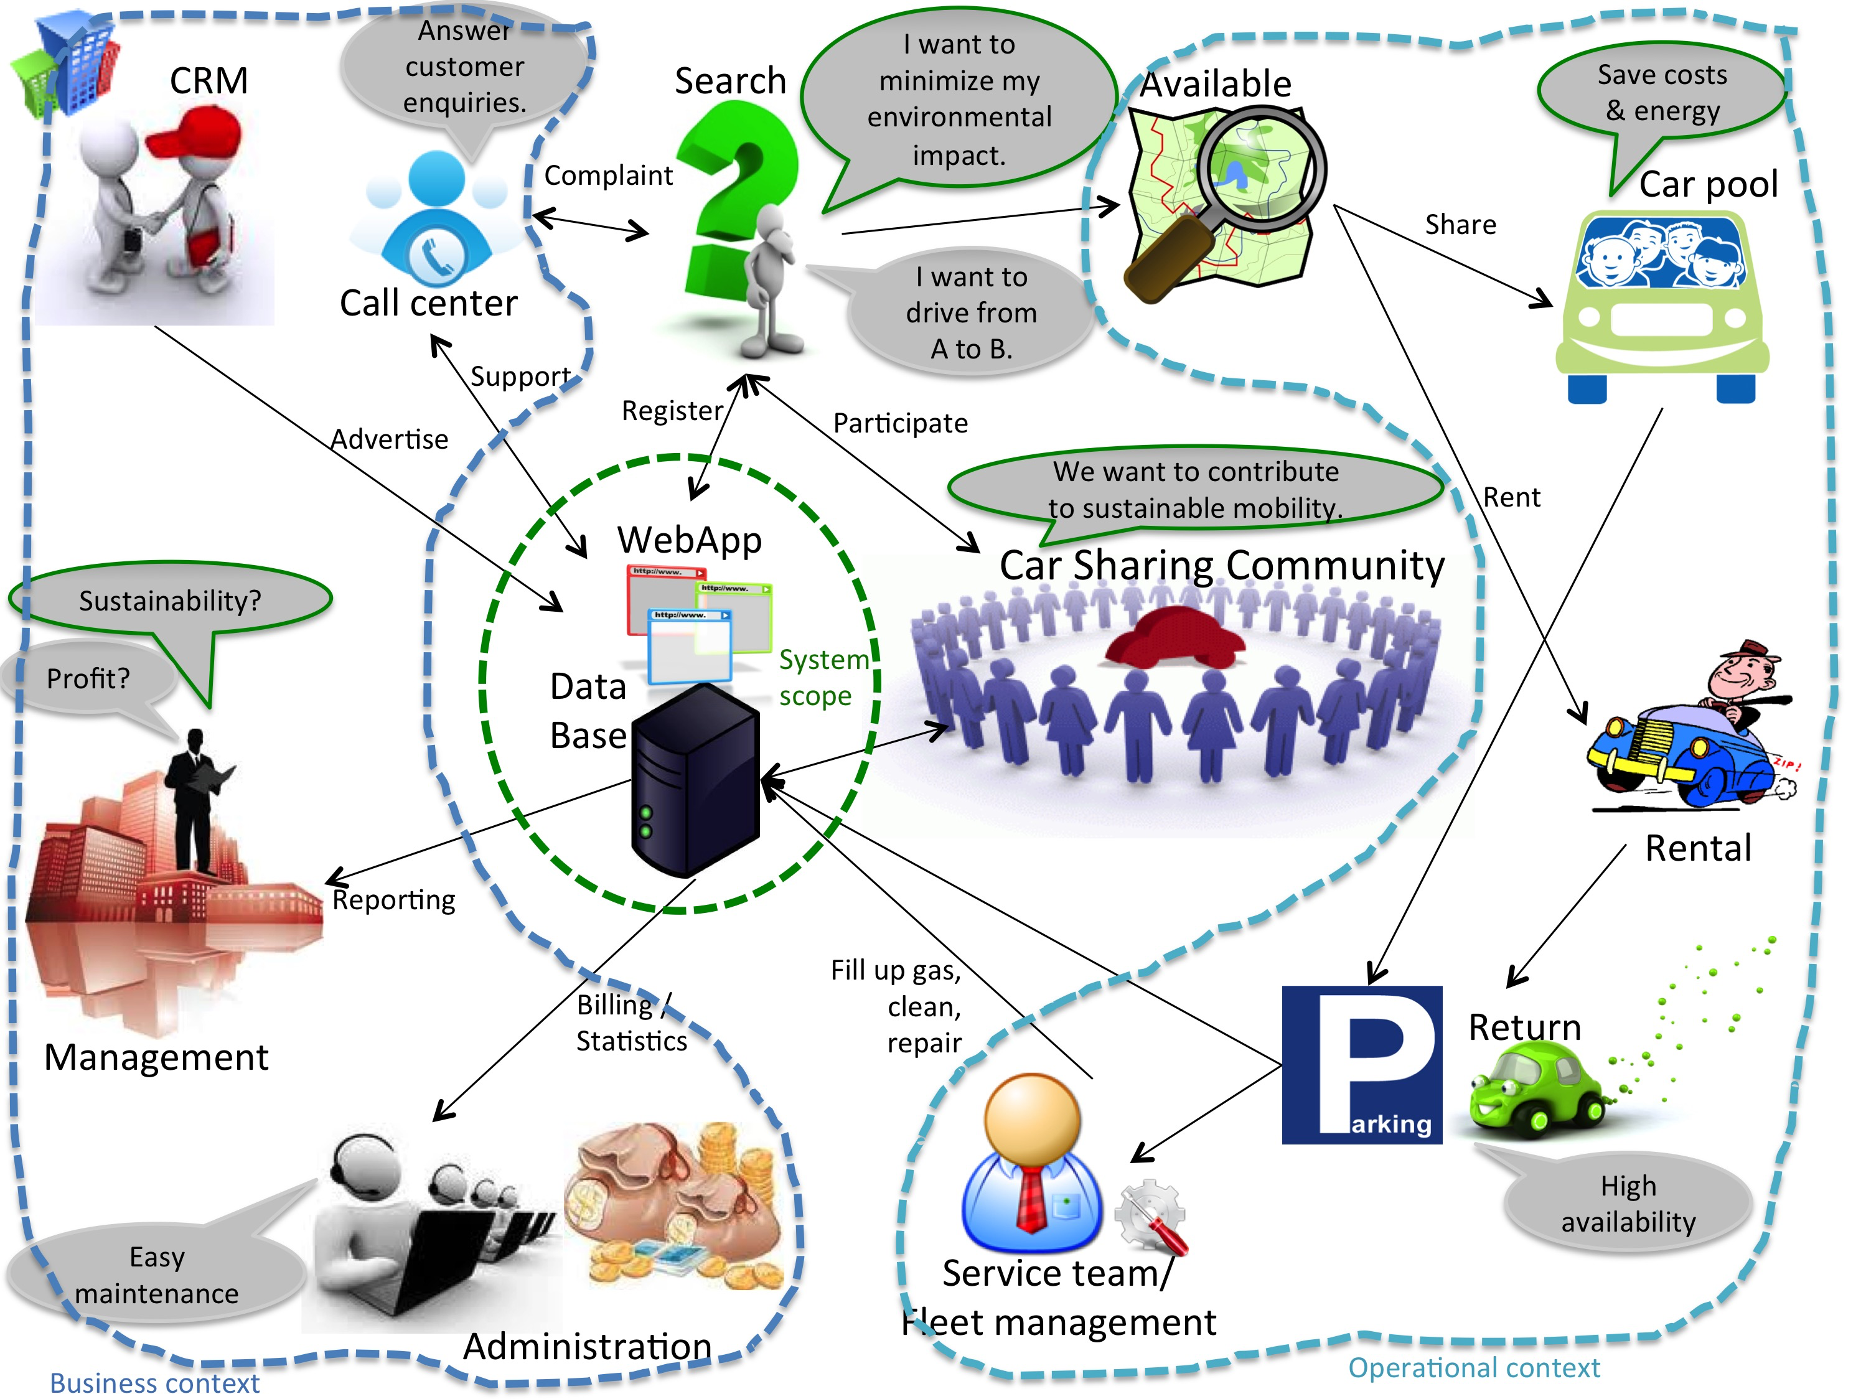
Topic 2: car sharing system
Predicates:
Locations of drivers
Locations of customers
Adjacencies of locations
Availability of drivers and customers
Cost functions – about road length?
Operators:
move, pickup, dropoff
Objects:
Drivers: d₁, d₂, …, d_{k}
Customers: c₁, c₂, …, c_{t}
Locations: l₁, l₂, …, l_{h}
Initial and goal states:
Status of objects
Replanning every other 5min!

Slide 7


Topic 3: Take-out scheduling system
Objects ?
Orders
Runners
Maps
Predicates ?
Actions ?
Initial and goal states ?

Slide 8
The end! Build your own applications easily!

